Slide 1
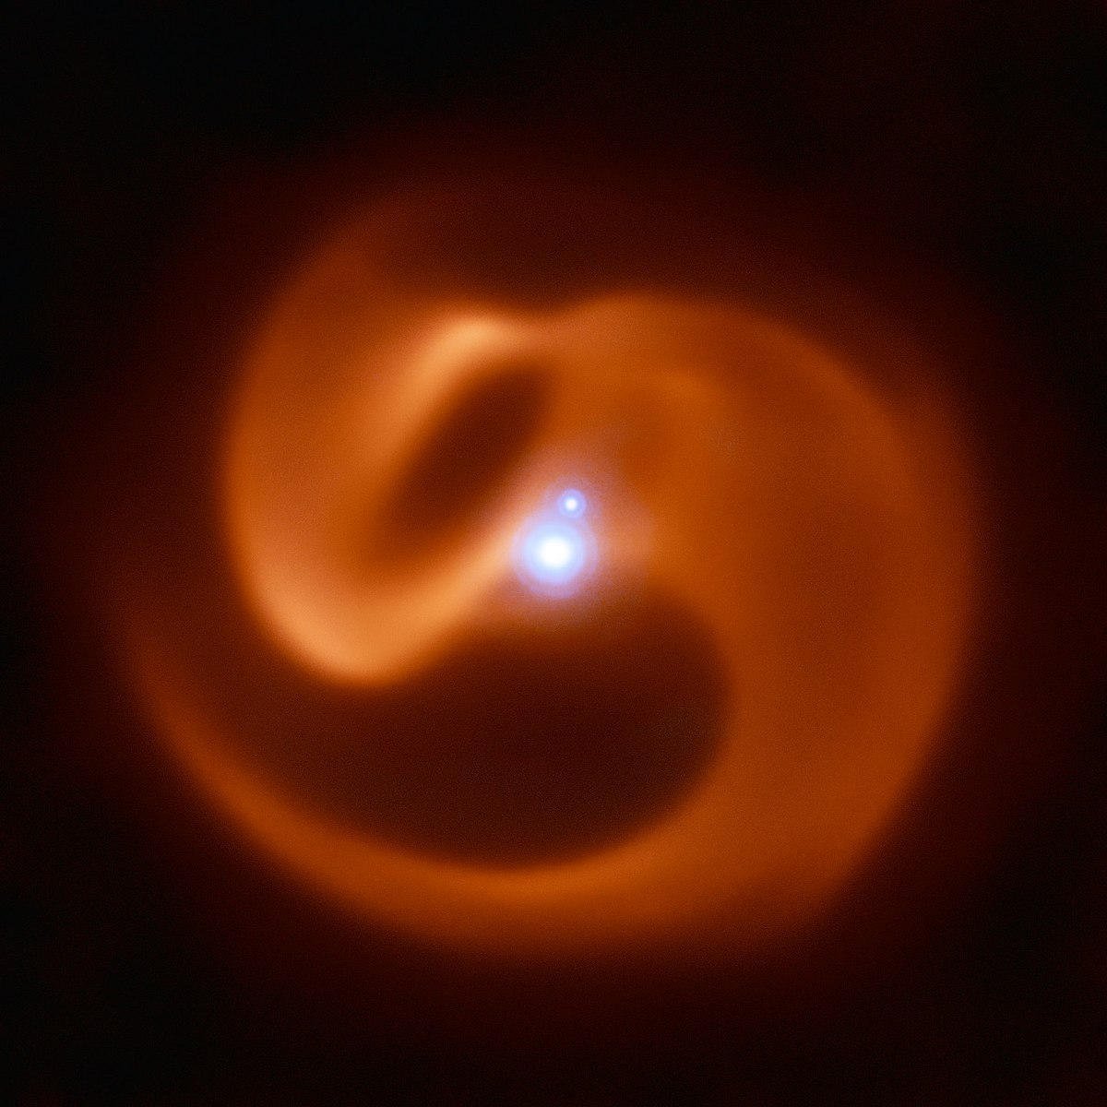
A Phenomenological Model for Wolf-Rayet Binary Dust Plumes
Ryan White
Dr Benjamin Pope (UQ)
Prof Peter Tuthill (USyd)

Slide 2
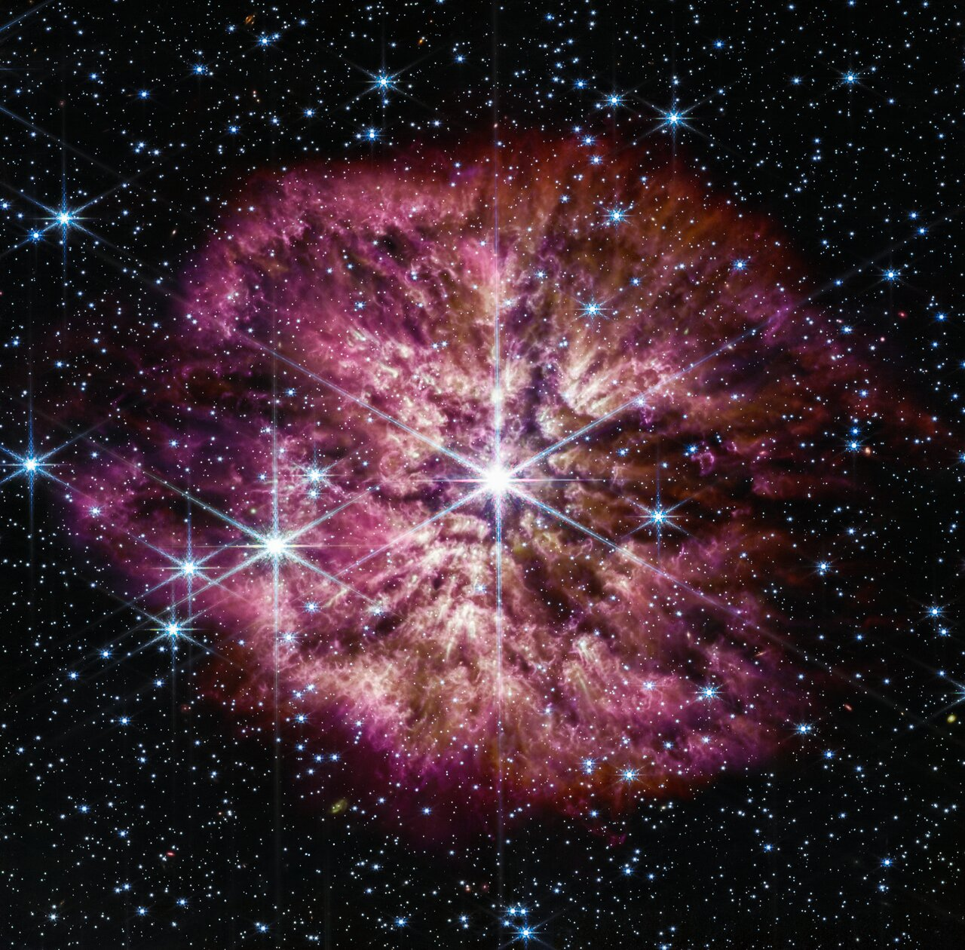
Wolf-Rayet Stars
Massive, extremely hot stars near the end of their lives
Very fast evolution
Core-collapse supernova progenitors
Produced some of the first carbon and heavy elements in the Universe
Few and far between in the present epoch, but common in young galaxies
WR124 NIRCam+MIRI Composite, NASA, ESA

Slide 3
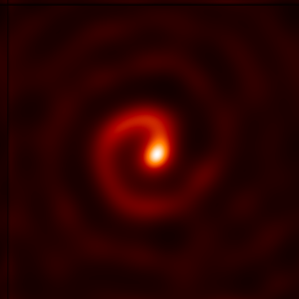
Colliding Wind Binaries
Considerable proportion of WRs are in “colliding wind” binaries with O/B/WR companions
Spiral plumes created as massive stars orbit each other
Dust nebulae are dynamic and repeating on ~human timescales!
Only first imaged ~20 years ago, as they’re bright in the infrared and require very high angular resolution
11 epochs of WR104, K-band on Keck

Slide 4
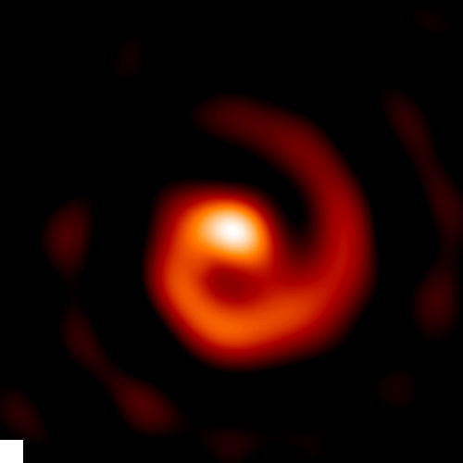
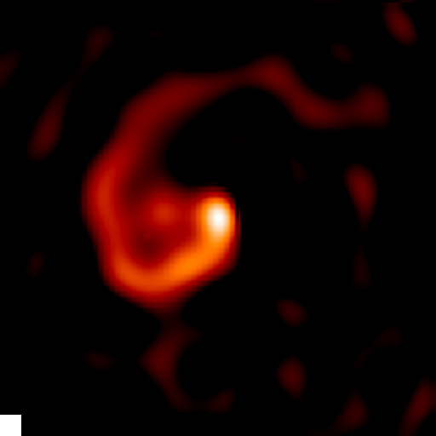
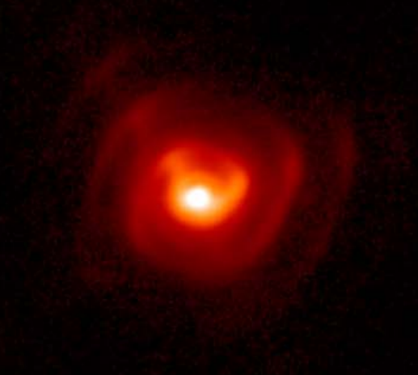

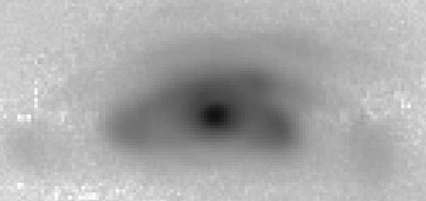
Colliding Wind Binaries
WR104
WR98a
WR112
Apep
WR48a

Slide 5
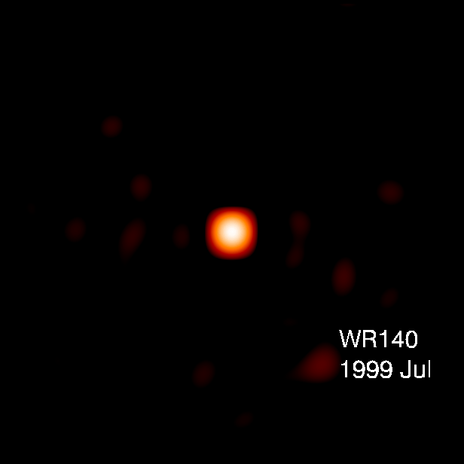
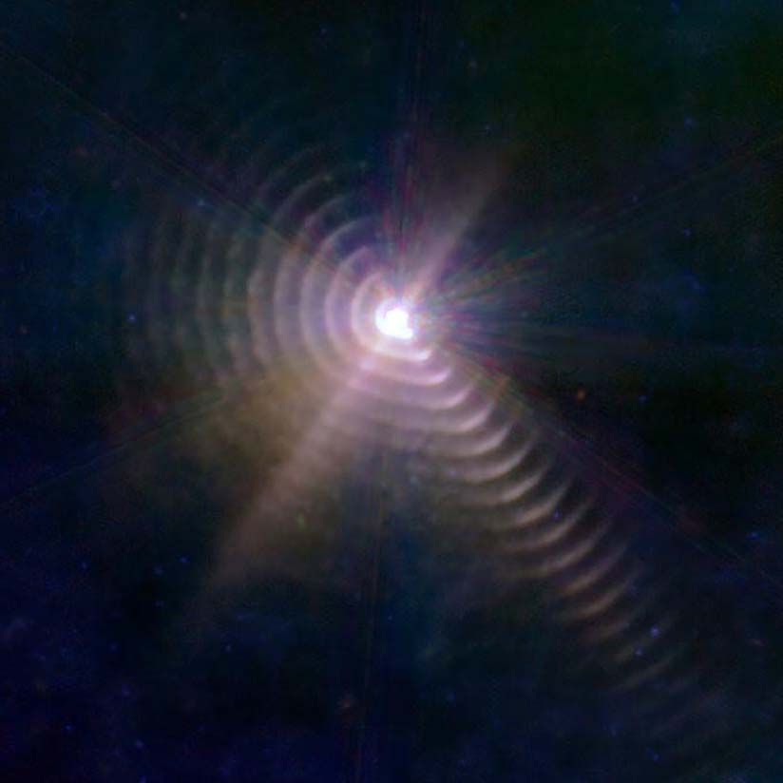
Colliding Wind Binaries

Slide 6
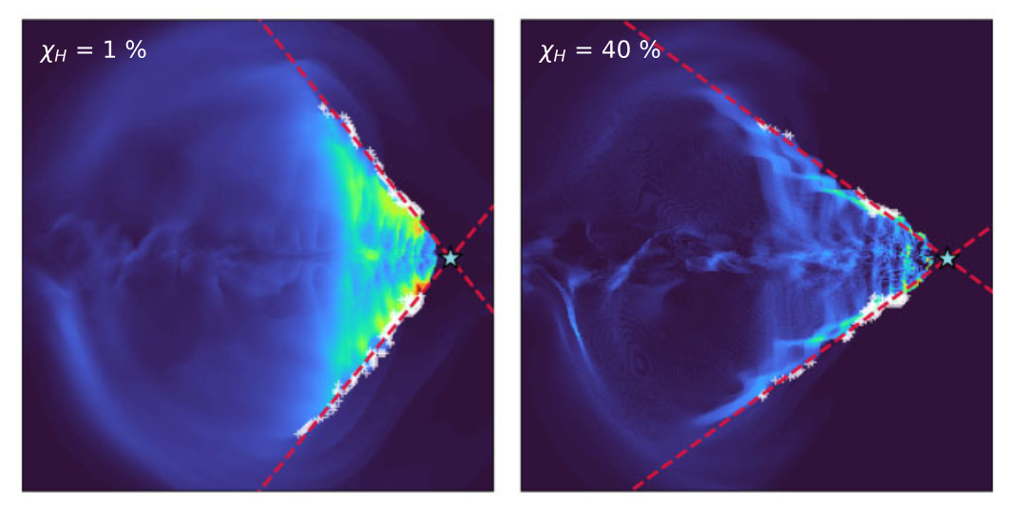
Colliding Wind Binaries
Spiral plumes encode stellar and orbital characteristics
Turbulent dynamics in the colliding wind region result in dust nucleation along a shock cone
Created dust is very bright in the near to mid IR
Hydrodynamical simulations reproduce physics well, but can’t quickly infer parameters
Soulain et al MNRAS 2022.

Slide 7
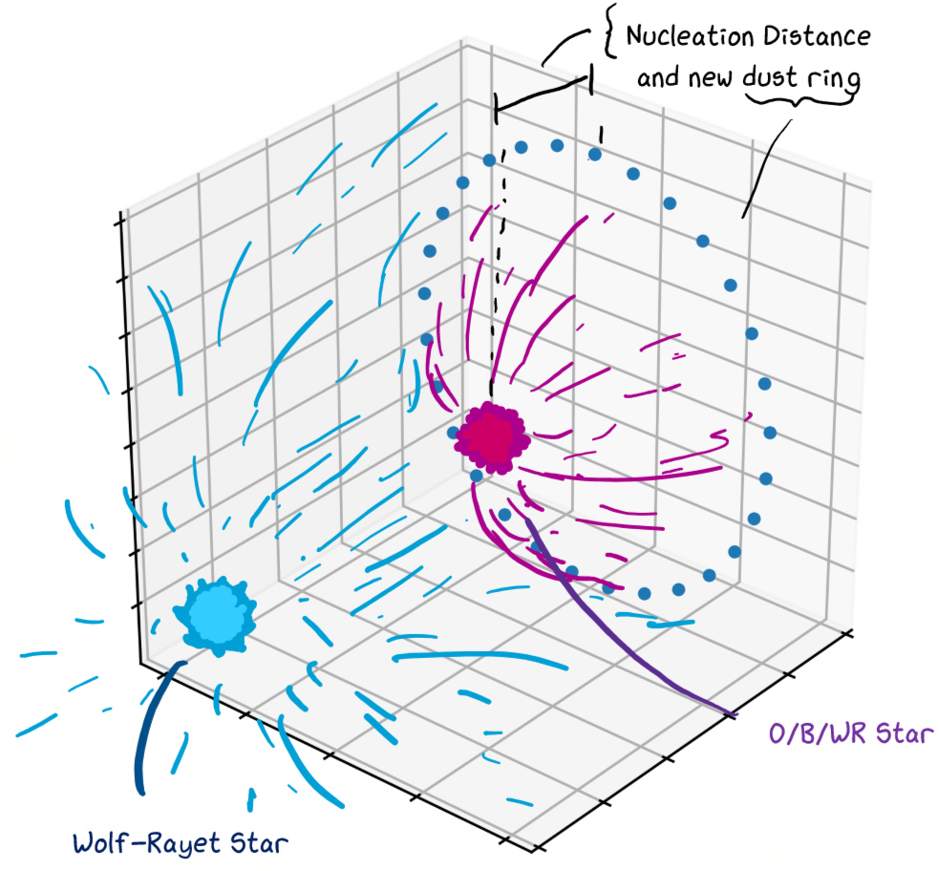
Modelling the dust plumes

Slide 8
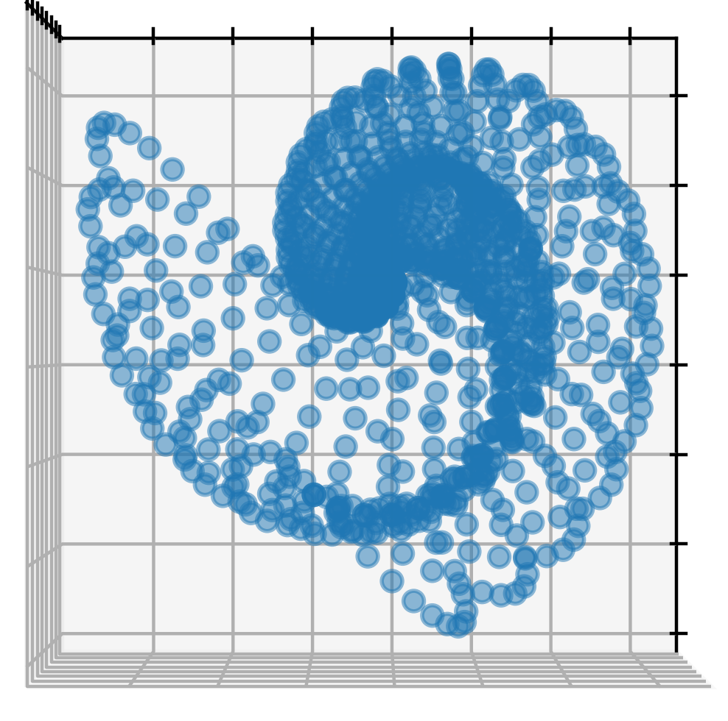
Modelling the dust plumes
Notes:
sgssa

Slide 9
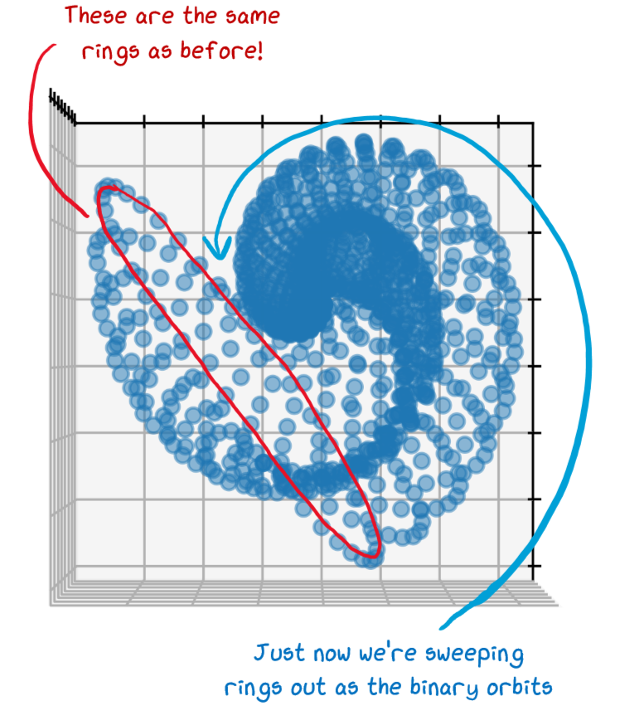
Modelling the dust plumes
Notes:
sgssa

Slide 10
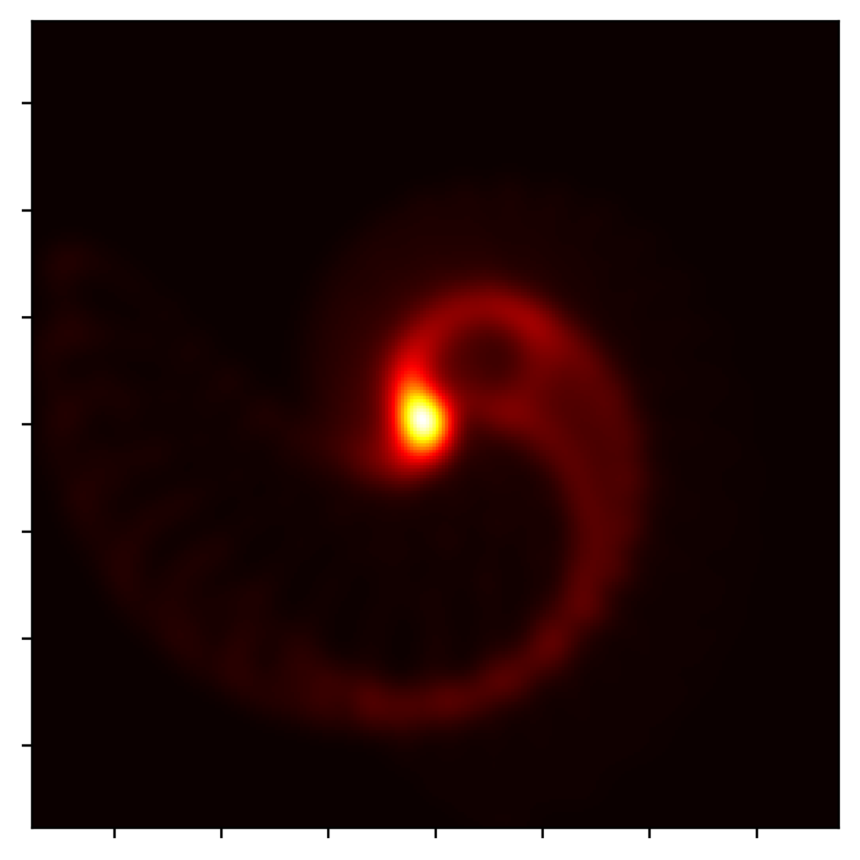
Modelling the dust plumes
Notes:
sgssa

Slide 11
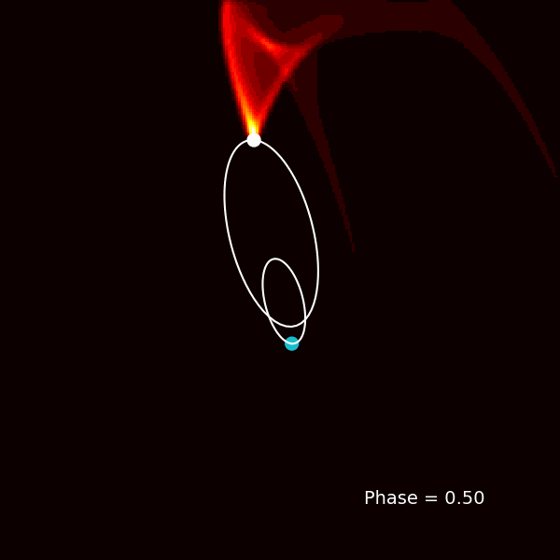
Modelling the dust plumes
Notes:
Aoinapoica poiajcap oa

Slide 12
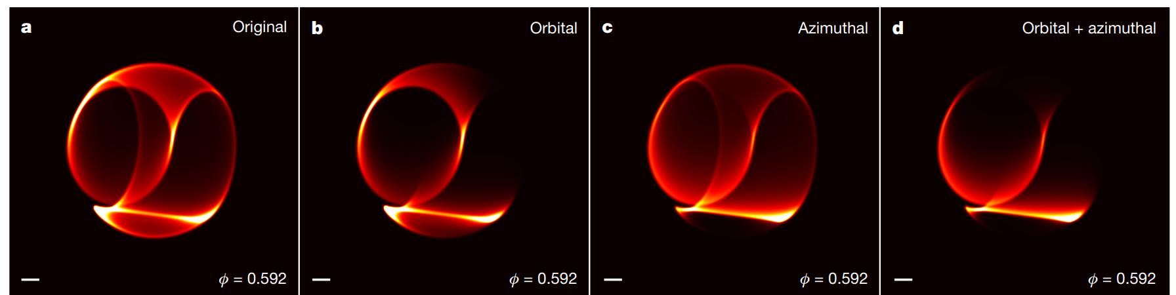
Dust plume intricacies
Credit: Yinuo Han et al, 2022

Slide 13
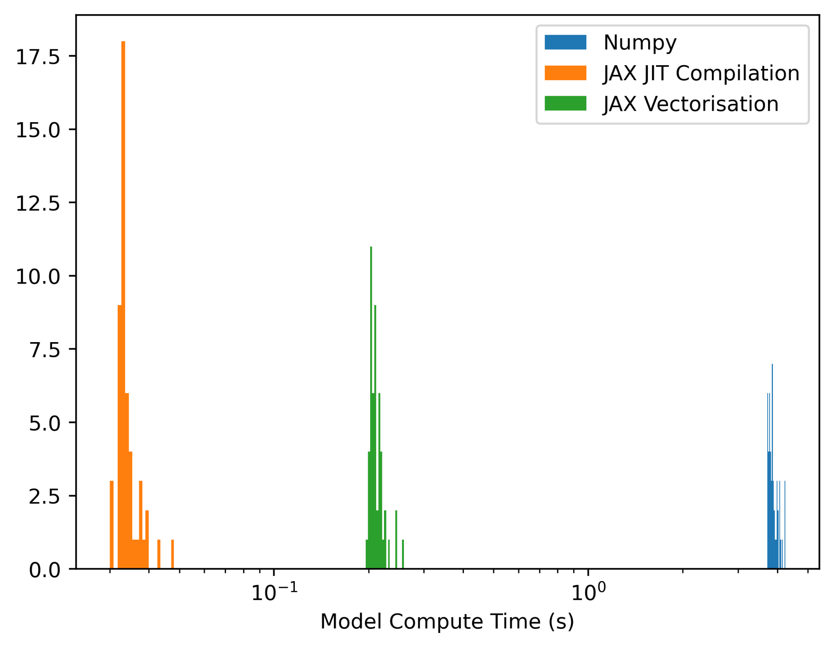
Speeding up the code
Previous versions of the model were too slow for MCMC
Over a dozen parameters to be fit simultaneously; we can’t do that without gradient-based methods
JAX comes with handy tools to speed up the code much faster than stock python or numpy

Slide 14
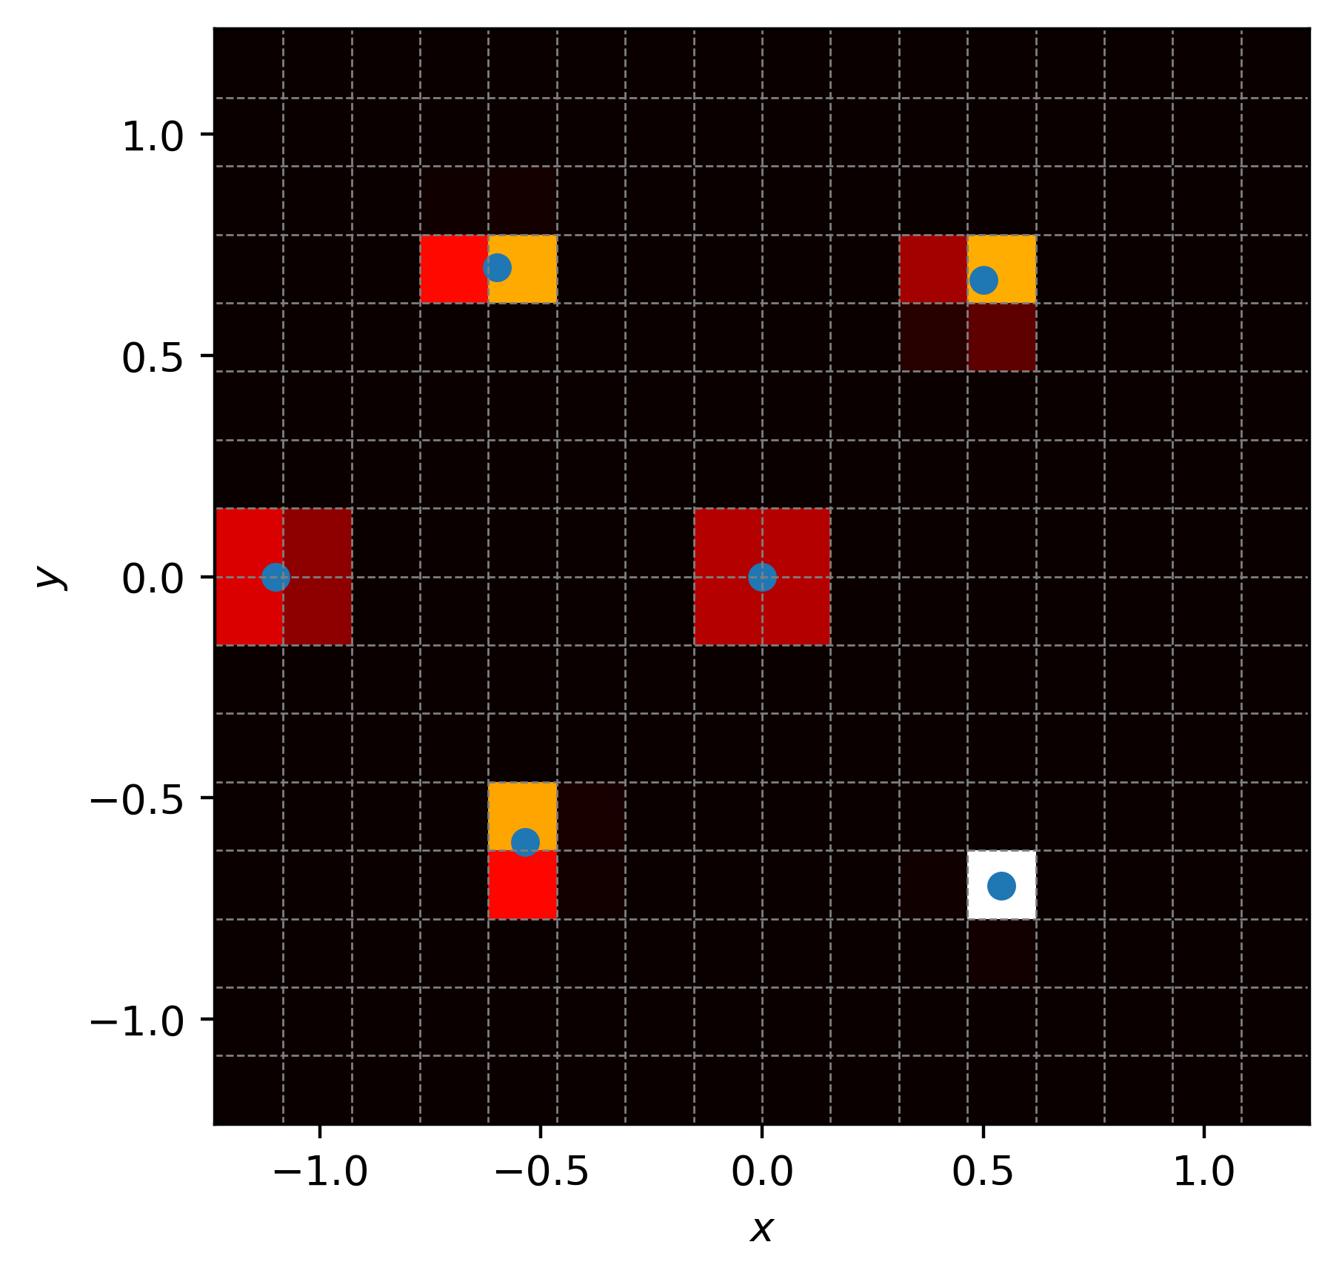
Gradient friendly renderer
Entire pipeline needs to be differentiable if HMC is the goal
JAX does the heavy lifting for the plume model
What about the ‘renderer’? Manual tweaking is needed!
We’ve developed a ‘smooth histogram’ renderer

Slide 15
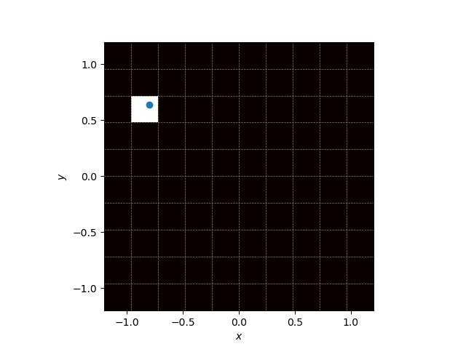
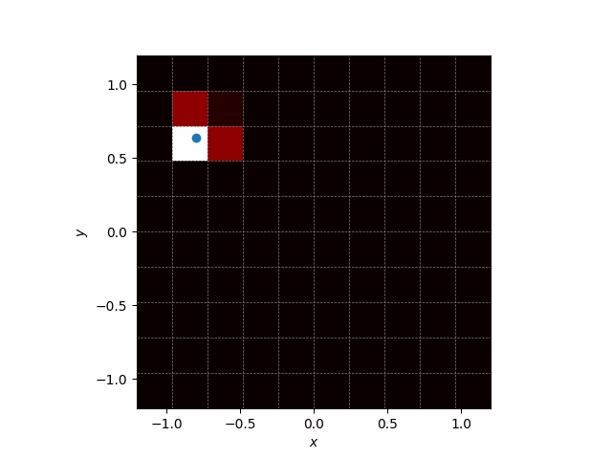
Gradient friendly renderer

Slide 16
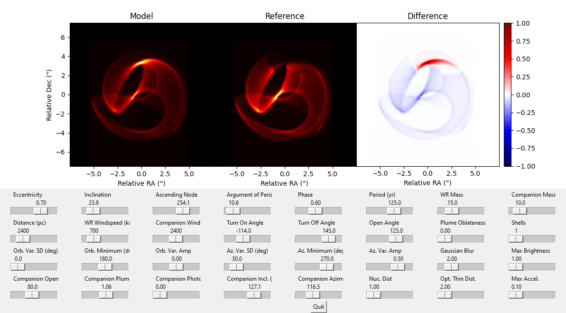
Speeding up the code
Notes:
sgssa

Slide 17
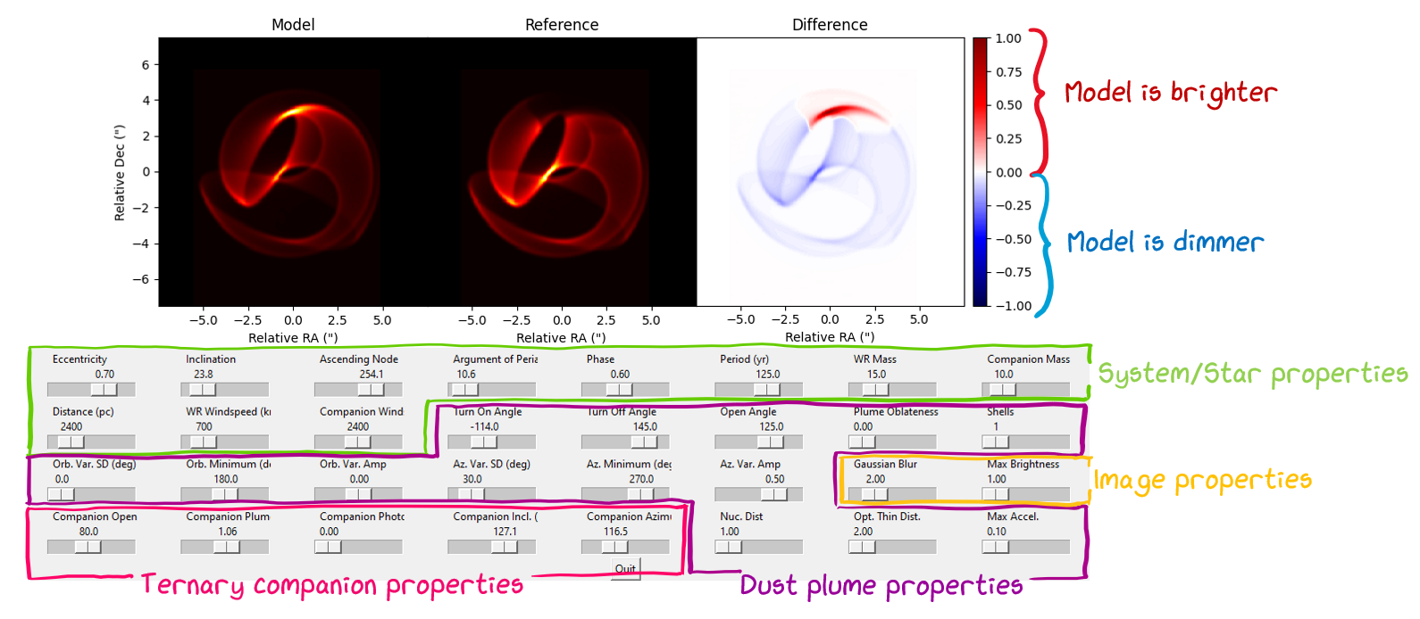
Speeding up the code
Notes:
sgssa

Slide 18
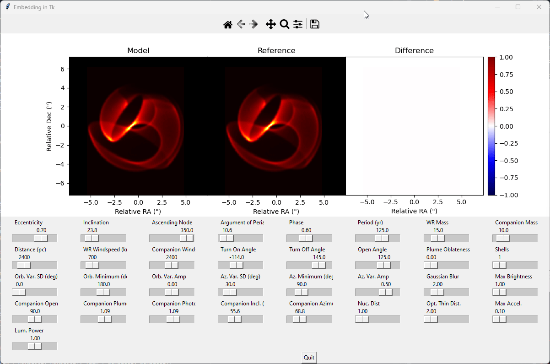
Speeding up the code
Notes:
sgssa

Slide 19
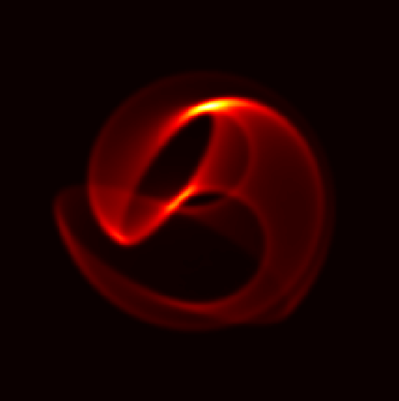
Ternary effects in Apep?

Slide 20
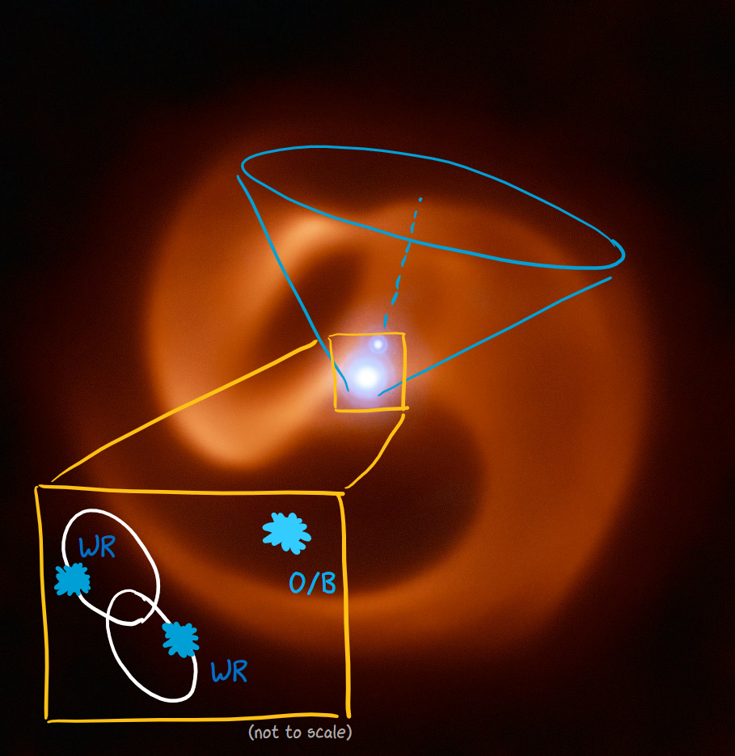
Ternary effects in Apep?

Slide 21
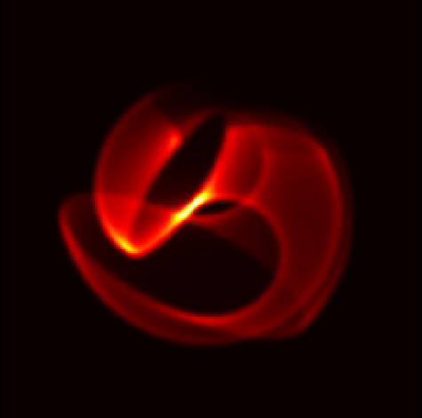
Ternary effects in Apep?

Slide 22
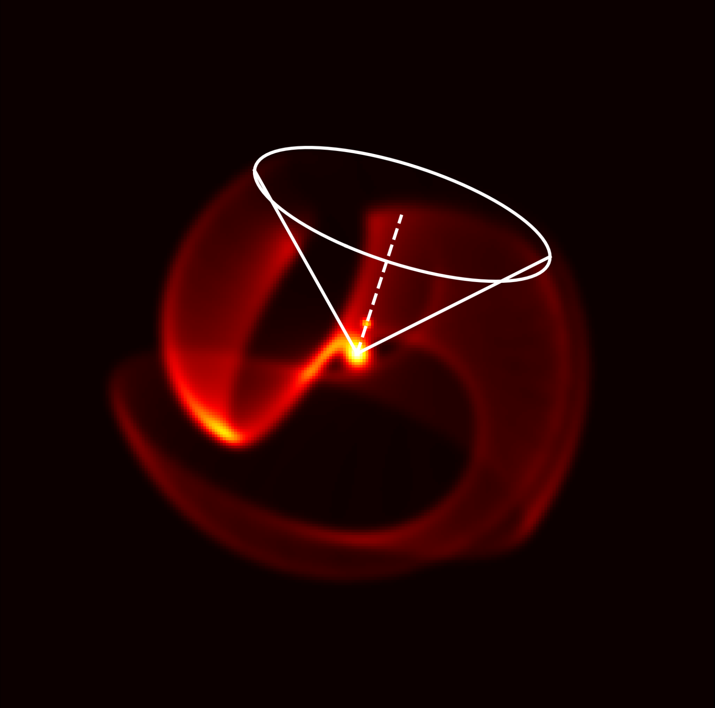
Ternary effects in Apep?

Slide 23
What’s next…
Inference with gradient based methods
Parameter estimation with other data (VLTI, ALMA)
Population synthesis to try to reproduce a WR+WR system
Fitting other systems with JWST data
Credit: Joe Callingham / ESO

Slide 24
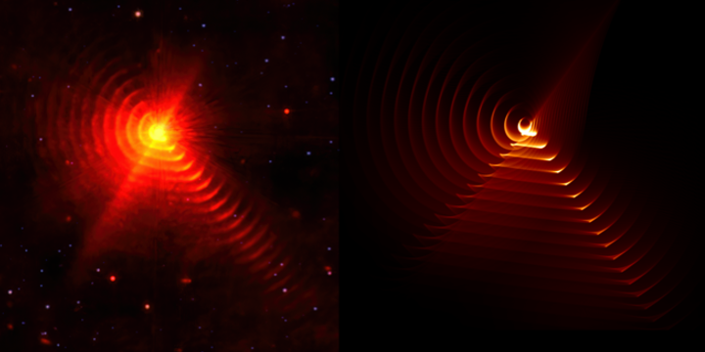
What’s next…
Inference with gradient based methods
Parameter estimation with other data (VLTI, ALMA)
Population synthesis to try to reproduce a WR+WR system
Fitting other systems with JWST data
Credit: Peter Tuthill / Yinuo Han / NASA/ESA

Slide 25
Questions?

